Slide 1

IT-632 Software Engineering

Slide 2

Neural Networks for Stock Prediction

Slide 3
Project members (Group id – 03)
Varun Shah (Project Guide) - 202011021
202112001 Vineeta Gurnani
202112015 Atharva Vaze
202112041 Abhinav Kakade
202112049 Varsha Bhootra
202112060 Yash Trivedi
202112071 Aman Goyal
202112074 Karan Patel
202112080 Nurudin Kudarati
202112091 Harshit Agarwal
202112096 Hani Patel
202112115 Divyansh Jain

Slide 4
Introduction
Every day there are millions of people who buy and sell stocks of various companies.
Thus, Terabytes or even Petabytes of data are being generated from different exchanges.
Financial organizations and retail traders can extract a great amount of information which can help them in their trading decisions.
Financial market is largely based on the daily trading of stock so by the use of machine learning techniques one can create prediction models which can predict the stock prices in advance.
The intended combination of sentiment analysis and Neural networks is used to establish a statistical relationship between historic numerical data records of a particular stock and other sentimental factors which can affect the stock prices.
Long short-term memory (LSTM) is an artificial recurrent neural network (RNN) architecture that you can use in the deep learning field. We can process an entire sequence of data.

Slide 5
Scope of our project
With the introduction of Machine Learning and its strong algorithms, the most recent market research and Stock Market Prediction advancements have begun to include such approaches in analyzing stock market data.
The total volume of the stocks in the market is provided, with this information, it is up to the job of a Machine Learning Data Scientist to look at the data and develop different algorithms that may help in finding appropriate stocks values.
With the application of machine learning for stock market forecasts, the procedure has become much simpler.

Slide 6
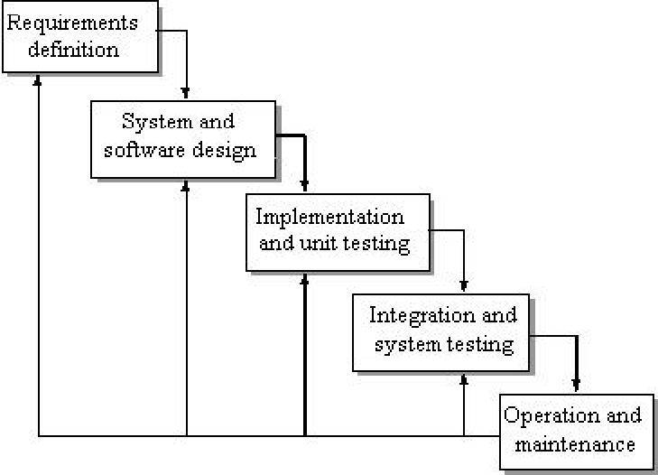
Process Model(Iterative Waterfall model)
The Iterative Waterfall Model is an extension of the Classic Waterfall Model.
There are some certain adjustments made in the Iterative Waterfall Model to boost the performance of software development.
There is limited customer interaction in our project, and the requirements are defined before starting the development phase.
There is a feedback path from one phase to its preceding stage.

Slide 7
Users of our system
Users :-
Users can register, login and create his/her profile.
Users can view the stock prediction
Users can compare the stock prices.
Users can view information about the stock market.
Users can also provide feedback.

Slide 8
Stakeholders of our system
Admin :-
Admin has all the rights to view the user's activities as he/she is the owner of the website.
Admin can compute the performance and result.
Admin can view the stock prices.
Admin can also view the information about the stock market and update them.
Admin can view the feedback provided by the user.

Slide 9
Other Stakeholders
Government
Financial Institutes
Stock Market Investors
NSE India
BSE India
Stock Market Researcher and Analyst
Investment Research firms

Slide 10
Requirement Gathering
LSTM model is used to predict the stock prices.
LSTM - The benefit of using a Long Short Term Memory neural network is that there is an extra element of long term memory, where the neural network has data about the data in prior layers as a 'memory' which allows the model to find the relationships between the data itself and between the data and output.
A full stack web application is used to display the stock prediction graphs to the user.
Tools & Technology Used :- Python, JavaScript, ReactJS, NodeJS, MongoDB

Slide 11
Functional Requirements
These are functions or features that must be included in a system to satisfy the need of the system and the user's expectation. Some of the functional requirements for our system are listed below:-
1) New user registration – Registration of a new user.
2) Data should be gathered from kaggle.com for more accurate data.
3) The software should accept the .csv dataset as an input only from the admin side.
4) User login: A registered user can login to the system by providing his user ID and
password as set by him while registering. After successful login, Home page for the
user is shown from where he can access the different functionalities.
5) Users can view data of particular stock according to time period.
6) User can view the opening price and closing price of a particular stock of each day.
7) User can set the limit of stock price to get notified whenever the stock price crosses the limit.

Slide 12
Non Functional Requirements
These are features that are included in the system on the basis of information, economic terms, security efficiency and services. Some non - functional requirements for our system are listed below :-
1) The system should provide better accuracy.
2) User should have a simple user interface to interact with the system.
3) User can also use the predictions of various stock prices to find the correlation and comparison between stocks.
4) Password reset: If user forgot his password then he can reset his account

Slide 13
Use Case Actors and Functionalities
Primary Actors: - Primary actors initiate a use case and hence are somewhat independent.
In our Use case diagram, the primary actor is the User.
Secondary Actors: - Other actors involved in the Use Case, and they provide services to the System.
In our Use Case diagram, the secondary actor is the Admin.
The functionalities that we have considered are as follows: -
1) Register
2) Login
3) Compare
4) View Stock Prediction
5) View Information
6) Feedback
7) Collect Data
8) Compute result and performance

Slide 14
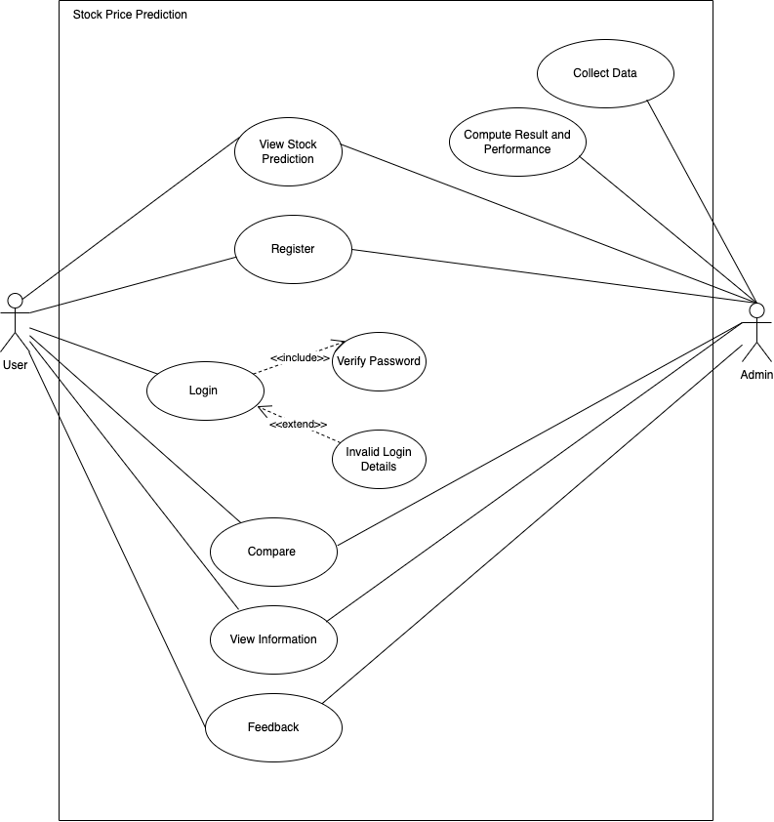
What is a Use Case Diagram?
The purpose of a use case diagram in UML is to demonstrate the different ways that a user might interact with a system.
Due to their simplistic nature, use case diagrams can be a good communication tool for stakeholders.

Slide 15
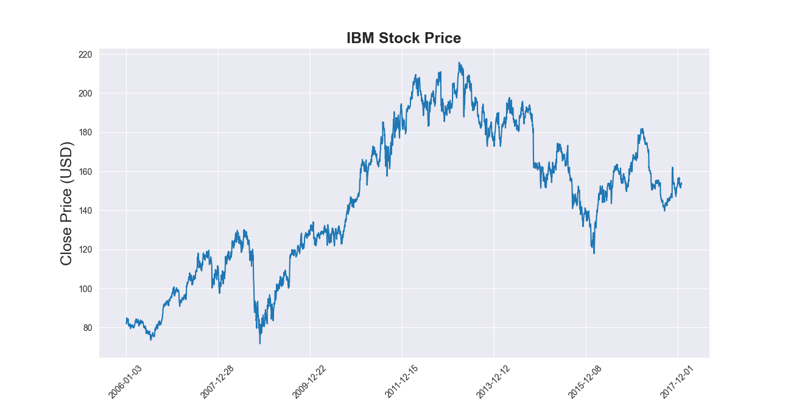
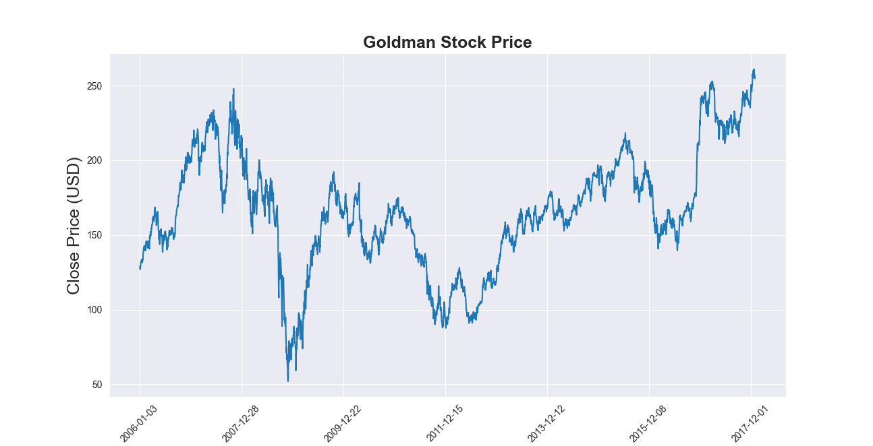
Preview of our data representation graph

Slide 16
Contribution
Honey, Varsha, Vineeta:
Define Scope of the project and Define Users and Stakeholders of the project.
Yash, Abhinav, Nuruddin:
Describe which process model is used for your project and also explain why choose the specific process model for your project and Use Case Diagram of the project.
Harshit, Divyansh, Aman:
Functional and Non-Functional Requirements of project as per process model.
Karan, Atharva :
Data set(python)

Slide 17
Thank You !!!

